Slide 1
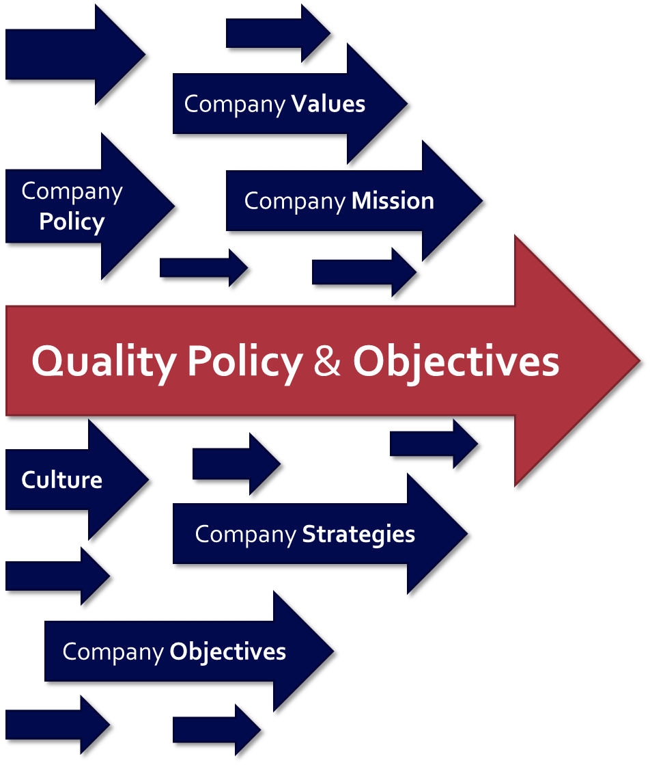
Notes:
Per ISO 13485:2016 “Top management shall ensure that the quality policy is applicable to the purpose of the organization" (section 5.3). Additionally "The quality objectives shall be measurable and consistent with the quality policy.” (section 5.4.1). This means that the quality policy and objectives need to be aligned with the organization, including the company's mission, values, strategies, and objectives.

